Slide 1
Lecture 1
Knowledge Base
Data, Information and Knowledge
Discrete and Continuous Attributes
Type of datasets

Slide 2
Data, Information, Knowledge
Data = facts.
Examples
Information is manipulated data.
Examples.
Knowledge is a theoretical or practical understanding of a subject or a domain.
Examples

Slide 3
Discrete and Continuous Attributes
Discrete Attribute
Has only a finite or countably infinite set of values
Examples: zip codes, counts, or the set of words in a collection of documents
Often represented as integer variables.
Note: binary attributes are a special case of discrete attributes
Continuous Attribute
Has real numbers as attribute values
Examples: temperature, height, or weight.
Practically, real values can only be measured and represented using a finite number of digits.
Continuous attributes are typically represented as floating-point variables.

Slide 4
Types of data sets
Record
Data Matrix
Document Data
Transaction Data
Graph
World Wide Web
Molecular Structures
Ordered
Spatial Data
Temporal Data
Sequential Data
Genetic Sequence Data

Slide 5
Data Matrix
If data objects have the same fixed set of numeric attributes, then the data objects can be thought of as points in a multi-dimensional space, where each dimension represents a distinct attribute
Such data set can be represented by an m by n matrix, where there are m rows, one for each object, and n columns, one for each attribute

Slide 6
Document Data
Each document becomes a `term' vector,
each term is a component (attribute) of the vector,
the value of each component is the number of times the corresponding term occurs in the document.

Slide 7
Transaction Data
A special type of record data, where
each record (transaction) involves a set of items.
For example, consider a grocery store. The set of products purchased by a customer during one shopping trip constitute a transaction, while the individual products that were purchased are the items.

Slide 8
Graph Data
Examples: Generic graph and HTML Links

Slide 9
Chemical Data
Benzene Molecule: C₆H₆

Slide 10
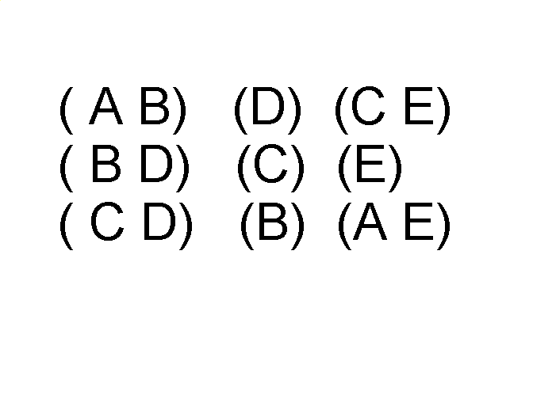
Ordered Data
Items/Events
Sequences of transactions
An element of the sequence

Slide 11
Ordered Data
Genomic sequence data

Slide 12
Ordered Data
Spatio-Temporal Data
Average Monthly Temperature of land and ocean

Slide 13
Introduction, or what is knowledge?
Knowledge is a theoretical or practical understanding of a subject or a domain. Knowledge is also the sum of what is currently known, and apparently knowledge is power. Those who possess knowledge are called experts.
Anyone can be considered a domain expert if he or she has deep knowledge (of both facts and rules) and strong practical experience in a particular domain. The area of the domain may be limited. In general, an expert is a skilful person who can do things other people cannot.

